Slide 1
Sigen C&I Gateway
Configuration Guide
2025/05/30

Slide 2
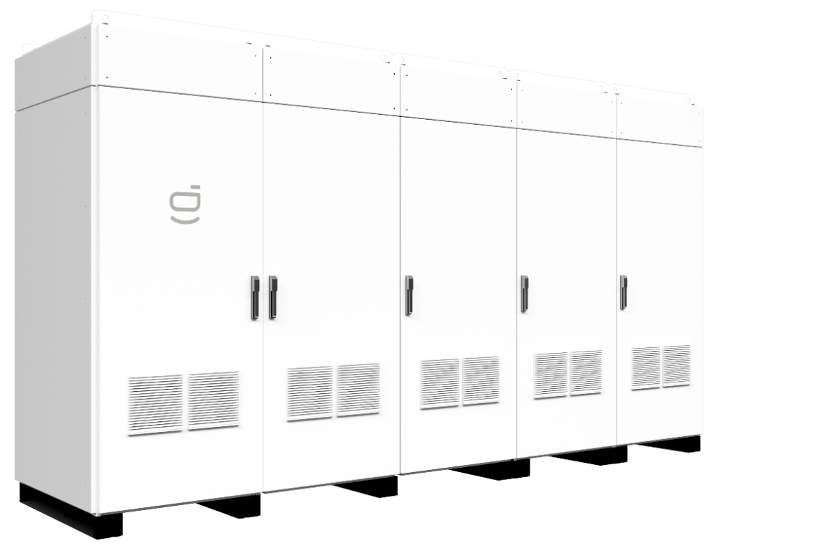
Sigen C&I Gateway Series for HYB Inverters
Item | Model | Description | Necessity of Configuration
Main Cabinet | Sigen Gateway C1600-B-MN | Gateway Main Cabinet with two inputs from grid and load, Including the grid and load air circuit breaker, which is standard in the gateway configuration | Standard Configure depend on the capacity of project: 1600kW, 2000kW and 2400kW
 | Sigen Gateway C2000-B-MN
 | Sigen Gateway C2400-B-MN
Smart Load Cabinet | Sigen Gateway C1600-B-ST | Gateway Smart Load Cabinet with one input from generator or smart load including third-part inverter | Optional Configure depend on the capacity of project: 1600kW, 2000kW and 2400kW Configure whether generator/smart load/3rd part inverter integration is needed
 | Sigen Gateway C2000-B-ST
 | Sigen Gateway C2400-B-ST
Inverter Cabinet * | Sigen Gateway B-INV-15 | Gateway Inverter Cabinet with 15/24 inputs from inverter side. | Standard Configure depend on the capacity of project and the power of HYB inverter
 | Sigen Gateway B-INV-24
2
3
1
Modular Cabinet Design
Note *:
Sigen Gateway B-INV-15 includes 15 units of inverter breakers, support all power range of HYB inverter
Sigen Gateway B-INV-24 includes 24 units of inverter breakers, support 50/60/80kW HYB inverter
Sigen Gateway Smart Cabinet is optional, which depends on whether the smart load or generator is needed to be integrated with Sigenergy system.
All the Sigen Gateway Cabinets are connected through busbar connection on site after being shipped separately
1
Sigen Gateway Main Cabinet
2
Sigen Gateway Smart Load Cabinet
3
Sigen Gateway Inverter Cabinet
Notes:
HYA 也能做离网运行，没有不平衡能力，上下半母线压差会很大，没有平衡桥，N相是虚接的，主要作用是为了采样盒保护
HYB 主要因为有平衡桥，上下半母线压差会平衡，平衡桥中间有N线引出，N线主要作用是可以提供相电压，离网下支持单相负载链接

Slide 3
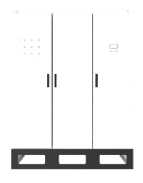
Basic Principles of Configuration
Selection of Main and Smart Load Cabinet
Selection of Inverter Cabinet
Size of Project | Main Cabinet | Smart Load Cabinet
AC Output(kW) | Standard | Optional (Generator/Smart Load)
≤1600 | Sigen Gateway C1600-B-MN | Sigen Gateway C1600-B-ST
≤2000 | Sigen Gateway C2000-B-MN | Sigen Gateway C2000-B-ST
≤2400 | Sigen Gateway C2400-B-MN | Sigen Gateway C2400-B-ST
Size of INV | Invert Cabinet
Model of HYB inverter | Standard
Sigen PV 50M1-HYB Sigen PV 60M1-HYB Sigen PV 80M1-HYB Sigen PV 100M1-HYB Sigen PV 110M1-HYB Sigen PV 125M1-HYB (Coming Soon) | Sigen Gateway B-INV-15
Sigen PV 50M1-HYB Sigen PV 60M1-HYB Sigen PV 80M1-HYB | Sigen Gateway B-INV-24
≤1200 kW
The Sigen Gateway C600-B
and Sigen Gateway C1200-B
are recommended
Note:
The Sigen Gateway Cxxxx-B-ST and Sigen Gateway Cxxxx-B-MN are not allowed to be mix-used with different power series. For example: Sigen Gateway C1600-B-ST can only be connected with Sigen Gateway C1600-B-MN
Note:
More than 1 Sigen Gateway B-INV-15/24 can be connected to Sigen Gateway Main Cabinet through busbar connection on site if the inverter number is more than 15 or 24.

Slide 4
1200~1600 kW Project Gateway Configuration
Sigen Gateway Main Cabinet: | 1 * Sigen Gateway C1600-B-MN
Sigen Gateway Smart Load Cabinet: | 1 * Sigen Gateway C1600-B-ST
✔
Standard in all scenario
✔
Need Generation/Smart Load Connection

No Generation/Smart Load Connection
Sigen Gateway Inverter Cabinet: | 1 * Sigen Gateway B-INV-15
✔
Support all power range of Sigen HYB inverter (50~125kW)
Maximum capacity for inverter input: 1,600kW
Typical Configuration of 1 * INV Cabinet
INV Model Selected | Recommended Inverter No. |  | Maximum INV Capacity | Maximum BESS Capacity | Backup Period | Remark
Sigen PV 100M1-HYB | 13~15 |  | 1,500kW | 3,795kWh | 2.5h | Maximum INV capacity: 1,600kW Maximum ESS capacity: 3,795kWh
Sigen PV 110M1-HYB | 11~14 |  | 1,540kW | 3,542kWh | 2.3h
Sigen PV 125M1-HYB | 10~12 |  | 1,500kW | 3,036kWh | 2.0h
Sigen PV 100M1-HYB Sigen PV 110M1-HYB | 5 * 100kW 10 * 110kW |  | 1,600kW | 3,795kWh | 2.4h
Note:
Since the maximum capacity design of Sigen Gateway B-INV-15 is 1,875kW, so 1 * Sigen Gateway B-INV-15 can meet the power need of inverter within 1600kW, but the backup time is almost 2 hours. If the client want to increase the backup time, the Sigen Gateway B-INV-24 is recommended.
Sigen PV 100M1-HYB / Sigen PV 110M1-HYB / Sigen PV 125M1-HYB is recommended to be used in the Sigen Gateway B-INV-15; Sigen PV 50M1-HYB/ Sigen PV 60M1-HYB / Sigen PV 80M1-HYB is recommended to be used in Sigen Gateway B-IN-24 for longer backup time.

Slide 5
1200~1600 kW Project Gateway Configuration
Sigen Gateway Main Cabinet: | 1 * Sigen Gateway C1600-B-MN
Sigen Gateway Smart Load Cabinet: | 1 * Sigen Gateway C1600-B-ST
✔
Standard in all scenario
✔
Need Generation/Smart Load Connection

No Generation/Smart Load Connection
Sigen Gateway Inverter Cabinet: | 1 * Sigen Gateway B-INV-24
✔
Support Sigen PV 50/60/80M1-HYB (50~80kW)
Maximum capacity for inverter input : 1,600kW
Typical Configuration of 1 * INV Cabinet
INV Model Selected | Recommended Inverter No. |  | Maximum INV Capacity | Maximum BESS Capacity | Backup Period | Remark
Sigen PV 60M1-HYB | 21~24 |  | 1,440kW | 6,072kWh | 4.2h | Maximum INV capacity: 1,600kW Maximum ESS capacity: 6,072kWh
Sigen PV 80M1-HYB | 16~20 |  | 1,600kW | 5,060kWh | 3.2h
Sigen PV 50M1-HYB Sigen PV 80M1-HYB | 1 1 * 50kW 13 * 80kW |  | 1,590kW | 6,072kWh | 3.8h
Note:
Since the maximum capacity design of Sigen Gateway B-INV-24 is 1,920kW, so 1 * Sigen Gateway B-INV-24 can meet the power need of inverter within 1,600kW.
If the client want to meet the AC power with 1,600kW and 5 hours backup time at the same time, 2*Sigen Gateway B-INV-24 and 32 * Sigen PV 50M1-HYB are needed.

Slide 6
1600~2000 kW Project Gateway Configuration
Sigen Gateway Main Cabinet: | 1 * Sigen Gateway C2000-B-MN
Sigen Gateway Smart Load Cabinet: | 1 * Sigen Gateway C2000-B-ST
✔
Standard in all scenario
✔
Need Generation/Smart Load Connection

No Generation/Smart Load Connection
Sigen Gateway Inverter Cabinet: | 1/2 * Sigen Gateway B-INV-15
✔
Support all power range of Sigen HYB inverter (50~125kW)
Maximum capacity for one cabinet: 15*125kW=1,875kW
Typical Configuration of INV Cabinet (1*Sigen Gateway B-INV-15)
INV Model Selected | Recommended Inverter No. | Maximum INV Capacity | Maximum BESS Capacity | Backup Period | Remark
Sigen PV 110M1-HYB | 15 | 1,650kW | 3,795kWh | 2.3h | Maximum INV capacity: 1,875kW Maximum ESS capacity: 3,795kWh
Sigen PV 125M1-HYB | 13~15 | 1,875kW | 3,795kWh | 2.0h
Typical Configuration of INV Cabinet (2*Sigen Gateway B-INV-15)
Sigen PV 60M1-M1 | 27-30 | 1,800kW | 7,590kWh | 4.2h | Maximum INV capacity: 2,000kW Maximum ESS capacity: 7,596kWh
Sigen PV 80M1-HYB | 21~25 | 2,000kW | 6,325kWh | 3.1h
Sigen PV 100M1-HYB | 16-20 | 2,000kW | 5,060kWh | 2.5h
Sigen PV 110M1-HYB | 15~18 | 1,980kW | 4,554kWh | 2.3h
Sigen PV 125M1-HYB | 13-16 | 2,000kW | 4,048kWh | 2.0h
Note:
1 * Sigen Gateway B-INV-15 can meet the power need of inverter within 1,875kW. The backup time is almost 2 hours. If the project size is over 1,875kW or need longer backup time, 2*Sigen Gateway B-INV-15 are needed.
Sigen PV 100M1-HYB / Sigen PV 110M1-HYB / Sigen PV 125M1-HYB is recommended to be used in the Sigen Gateway B-INV-15; Sigen PV 50/60/80 M1-HYB is recommended to be used in Sigen Gateway B-IN-24 for longer backup time.
If the client want to meet the AC power with 2,000kW and 5 hours backup time at the same time, 2*Sigen Gateway B-INV-24 and 40 * Sigen PV 50M1-HYB are needed.

Slide 7
1600~2000 kW Project Gateway Configuration
Sigen Gateway Main Cabinet: | 1 * Sigen Gateway C2000-B-MN
Sigen Gateway Smart Load Cabinet: | 1 * Sigen Gateway C2000-B-ST
✔
Standard in all scenario
✔
Need Generation/Smart Load Connection

No Generation/Smart Load Connection
Sigen Gateway Inverter Cabinet: | 1/2 * Sigen Gateway B-INV-24
✔
Support all power range of Sigen HYB inverter (50~80kW)
Maximum capacity for one cabinet: 24*80kW=1,920kW
Typical Configuration of INV Cabinet (1*Sigen Gateway B-INV-24)
INV Model Selected | Recommended Inverter No. | Maximum INV Capacity | Maximum BESS Capacity | Backup Period | Remark
Sigen PV 80M1-HYB | 21-24 | 1,920kW | 6,072kWh | 3.2h | Maximum INV capacity: 1,920kW Maximum ESS capacity: 6,072kWh
Typical Configuration of INV Cabinet (2*Sigen Gateway B-INV-24)
Sigen PV 50M1-HYB | 33-40 | 2,000kW | 10,120kWh | 5.1h | Maximum INV capacity: 2,000kW Maximum ESS capacity: 10,120kWh
Sigen PV 60M1-HYB | 27~33 | 1,980kW | 8,349kWh | 4.2h
Sigen PV 80M1-HYB | 21~25 | 2,000kW | 6,325kWh | 3.2h
Note:
1 * Sigen Gateway B-INV-24 can meet the power need of inverter within 1,920kW. The backup time is 3 hours. If the project size is over 1,920kW, 2*Sigen Gateway B-INV-24 are needed.
If the client want to meet the AC power with 2,000kW and 5 hours backup time at the same time, 2*Sigen Gateway B-INV-24 and 40 * Sigen PV 50M1-HYB are needed.

Slide 8
2000~2400 kW Project Gateway Configuration
Sigen Gateway Main Cabinet: | 1 * Sigen Gateway C2400-B-MN
Sigen Gateway Smart Load Cabinet: | 1 * Sigen Gateway C2400-B-ST
✔
Standard in all scenario
✔
Need Generation/Smart Load Connection

No Generation/Smart Load Connection
Sigen Gateway Inverter Cabinet: | 2 * Sigen Gateway B-INV-15
✔
Support all power range of Sigen HYB inverter (50~125kW)
Maximum capacity for one cabinet: 15*125kW=1,875kW
Typical Configuration of INV Cabinet (2*Sigen Gateway B-INV-15)
INV Model Selected | Recommended Inverter No. |  | Maximum INV Capacity | Maximum BESS Capacity | Backup Period | Remark
Sigen PV 80M1-HYB | 26~30 |  | 2,400kW | 7,590kWh | 3.2h | Maximum INV capacity: 2,400kW Maximum ESS capacity: 7,590kWh
Sigen PV 100M1-HYB | 21-24 |  | 2,400kW | 6,072kWh | 2.5h
Sigen PV 110M1-HYB | 19~21 |  | 2,310kW | 5,313Wh | 2.3h
Sigen PV 125M1-HYB | 17~19 |  | 2,375kW | 4,807kWh | 2.0h
Note:
2 * Sigen Gateway B-INV-15 can meet the power need of inverter within 2,400kW, but the backup time is almost 2-4 hours. If the client want to increase the backup time to 5 hours, 2 * Sigen Gateway B-INV-24 are recommended.
Sigen PV 80M1-HYB / Sigen PV 100M1-HYB / Sigen PV 110M1-HYB / Sigen PV 125M1-HYB is recommended to be used in the Sigen Gateway B-INV-15

Slide 9
2000~2400 kW Project Gateway Configuration
Sigen Gateway Main Cabinet: | 1 * Sigen Gateway C2400-B-MN
Sigen Gateway Smart Load Cabinet: | 1 * Sigen Gateway C2400-B-ST
✔
Standard in all scenario
✔
Need Generation/Smart Load Connection

No Generation/Smart Load Connection
Sigen Gateway Inverter Cabinet: | 2 * Sigen Gateway B-INV-24
✔
Support all power range of Sigen HYB inverter (50~80kW)
Maximum capacity for one cabinet: 24*80kW=1,920kW
Typical Configuration of INV Cabinet (2*Sigen Gateway B-INV-24)
INV Model Selected | Recommended Inverter No. |  | Maximum INV Capacity | Maximum BESS Capacity | Backup Period | Remark
Sigen PV 50M1-HYB | 41~48 |  | 2,400kW | 12,144kWh | 5.1h | Maximum INV capacity: 2,400kW Maximum ESS capacity: 12,144kWh
Sigen PV 60M1-HYB | 34~40 |  | 2,400W | 10,120kWh | 4.2h
Sigen PV 80M1-HYB | 26~30 |  | 2,400W | 7,590kWh | 3.2h
Note:
2 * Sigen Gateway B-INV-24 can meet the power need of inverter within 2,400kW. The max. backup time is 5 hours.

